Slide 1

Machine Learning
By Himanshu Shukla (Data Scientist & Statistical Expert)

Slide 2
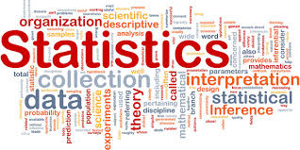

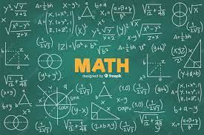
From Where We should Start

Slide 3
What is Statistics
It is a branch of mathematics dealing with the collection, analysis, interpretation, and presentation of masses of numerical data.

Slide 4
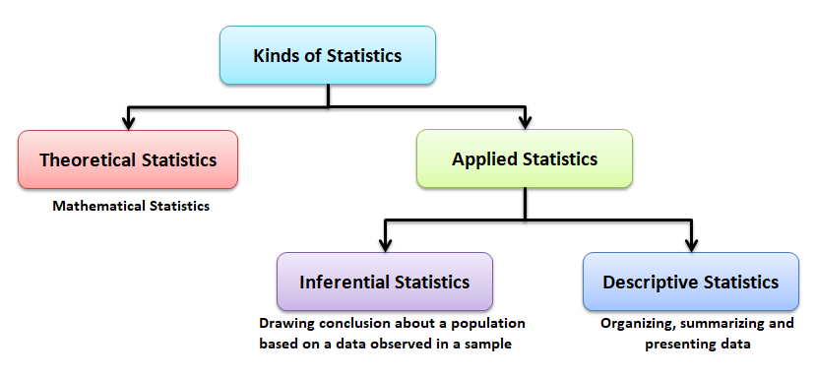

Slide 5
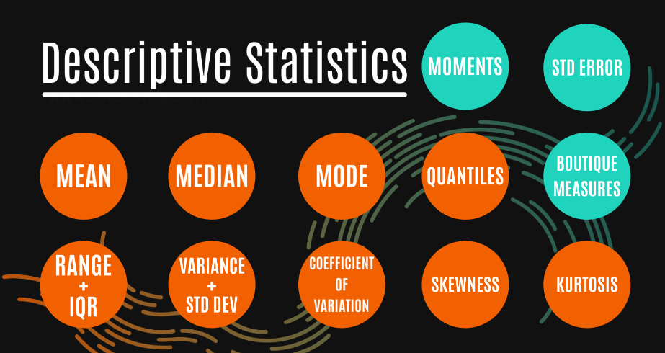

Slide 6
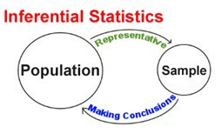

Slide 7
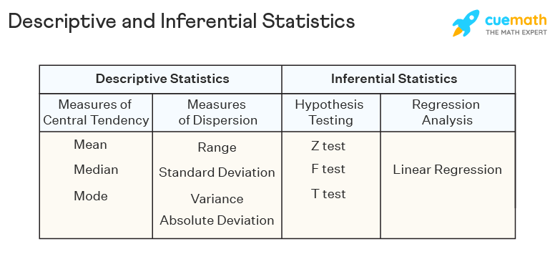
Machine Learning

Slide 8
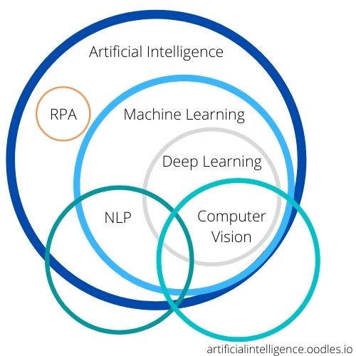
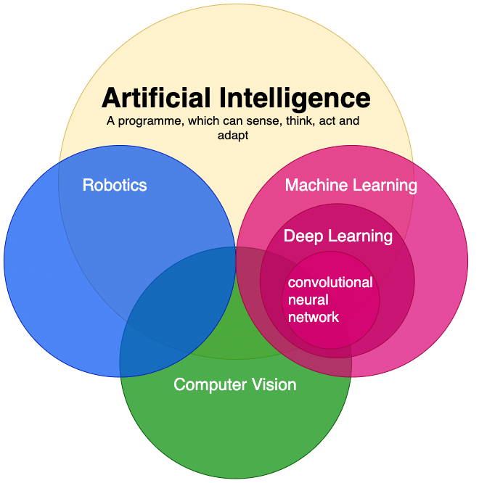
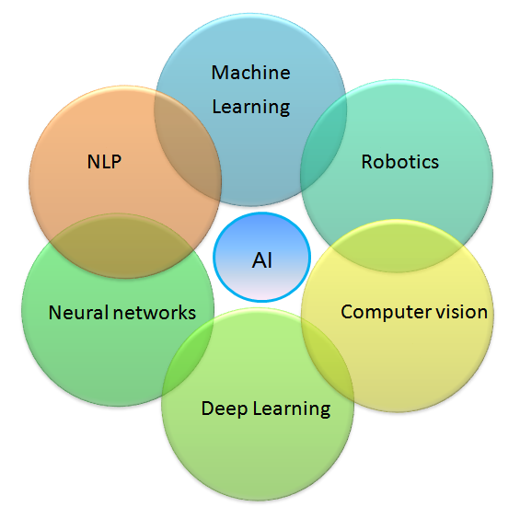
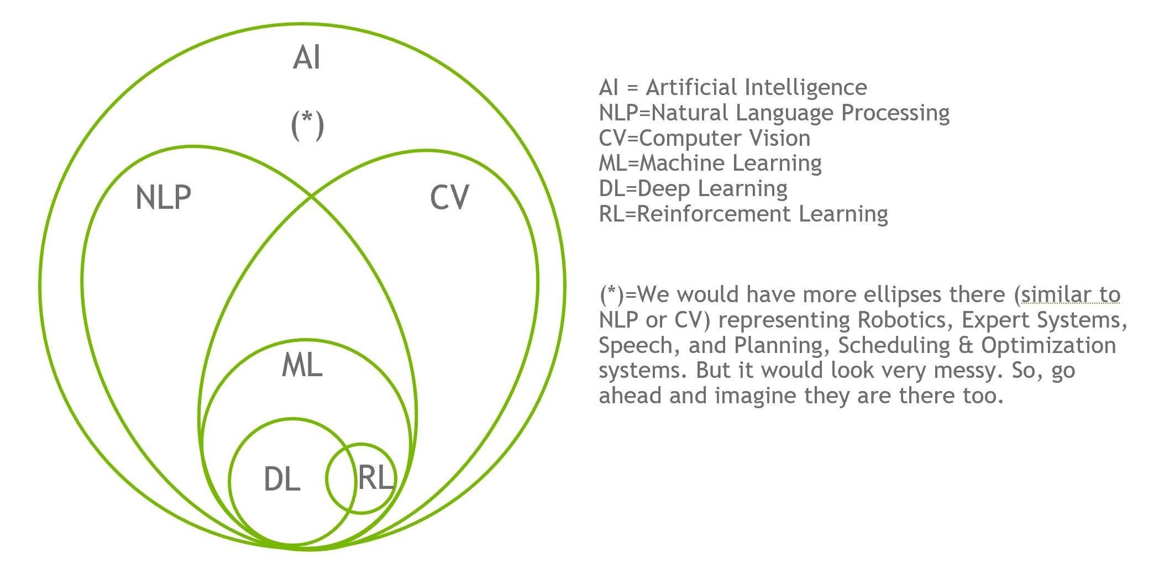
What is DS

Slide 9
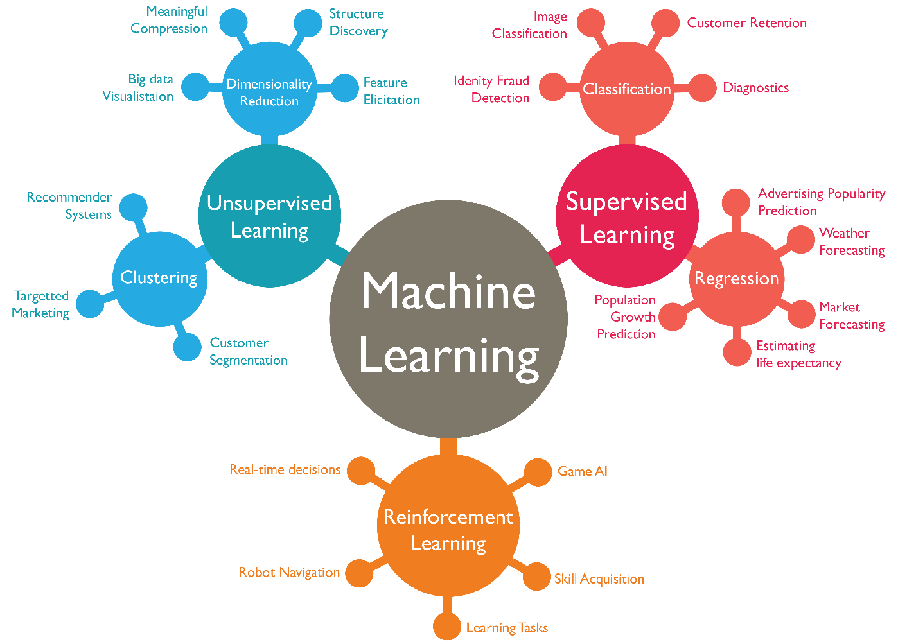
What is ML
Machine learning is actually a sub field/type of AI.

Slide 10
What is ML
Machine Learning (ML) can be explained as automating and improving the learning process of computers based on their experiences without being actually programmed i.e. without any human assistance.
The process starts with feeding good quality data and then training our machines (computers) by building machine learning models using the data and different algorithms.
The choice of algorithms depends on what type of data do we have and what kind of task we are trying to automate.

Slide 11
There are majorly three types of machine learning algorithms:
Supervised
Unsupervised
Semi-supervised
Reinforcement

Slide 12
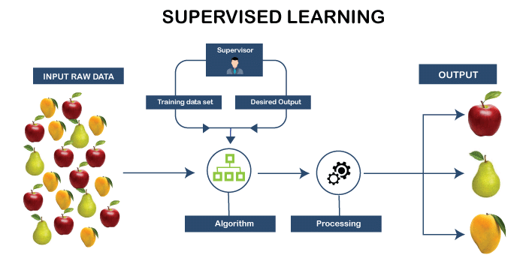
Supervised ML
In supervised learning, the machine is taught by example.
The operator provides the machine learning algorithm with a known dataset that includes desired inputs and outputs, and the algorithm must find a method to determine how to arrive at those inputs and outputs.
While the operator knows the correct answers to the problem, the algorithm identifies patterns in data, learns from observations and makes predictions.
The algorithm makes predictions and is corrected by the operator – and this process continues until the algorithm achieves a high level of accuracy/performance.

Slide 13
Under the umbrella of supervised learning fall: Classification, Regression and Forecasting.
Classification: In classification tasks, the machine learning program must draw a conclusion from observed values and determine to what category new observations belong. For example, when filtering emails as ‘spam’ or ‘not spam’, the program must look at existing observational data and filter the emails accordingly.
Regression: In regression tasks, the machine learning program must estimate – and understand – the relationships among variables. Regression analysis focuses on one dependent variable and a series of other changing variables – making it particularly useful for prediction and forecasting.
Forecasting: Forecasting is the process of making predictions about the future based on the past and present data, and is commonly used to analyze trends.

Slide 14
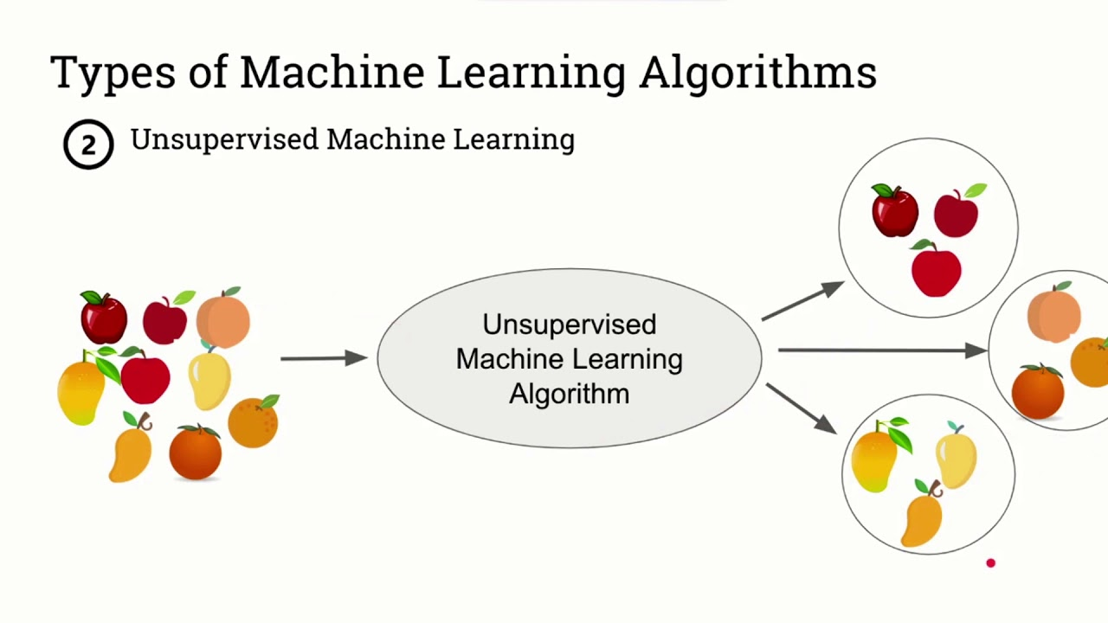
Unsupervised ML
Here, the machine learning algorithm studies data to identify patterns.
There is no answer key or human operator to provide instruction. Instead, the machine determines the correlations and relationships by analyzing available data.
In an unsupervised learning process, the machine learning algorithm is left to interpret large data sets and address that data accordingly.
The algorithm tries to organize that data in some way to describe its structure
. This might mean grouping the data into clusters or arranging it in a way that looks more organized.

Slide 15
Under the umbrella of unsupervised learning, fall:
Clustering: Clustering involves grouping sets of similar data (based on defined criteria). It’s useful for segmenting data into several groups and performing analysis on each data set to find patterns.
Dimension reduction: Dimension reduction reduces the number of variables being considered to find the exact information required.

Slide 16
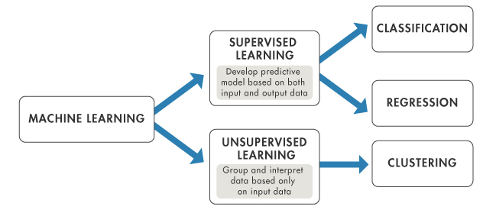

Slide 17
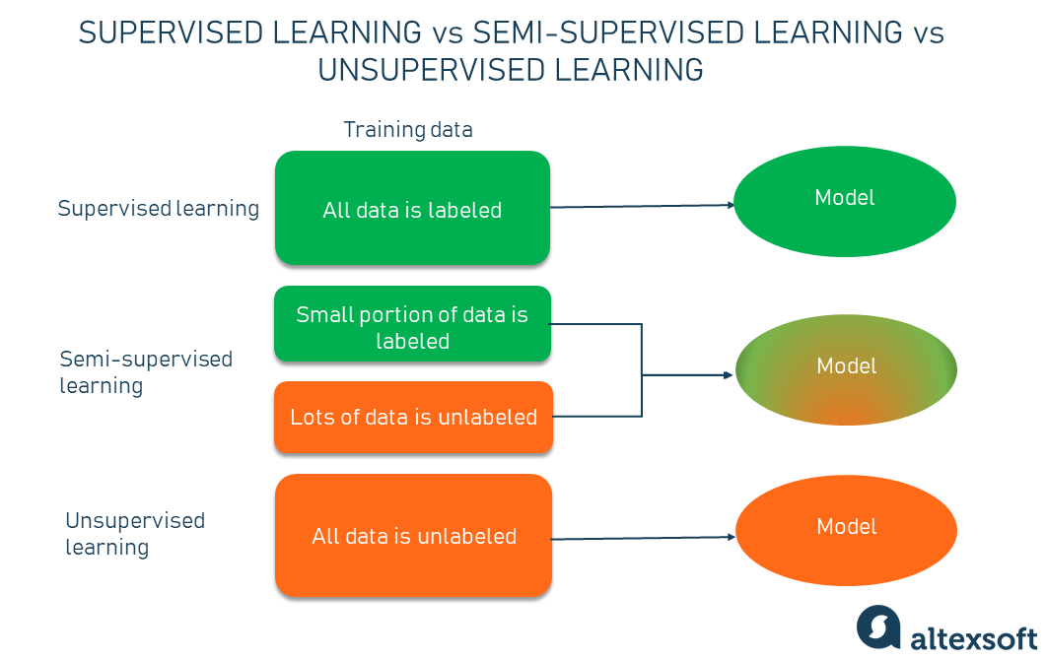
Semi-Supervised ML

Slide 18

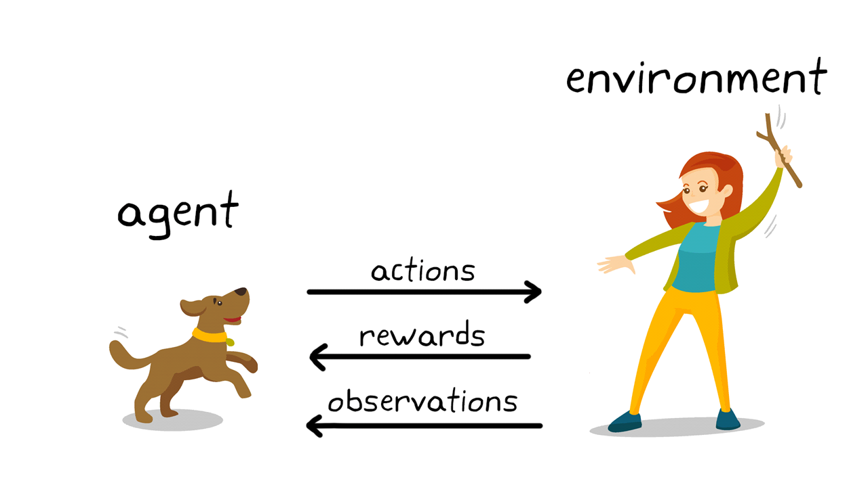
Reinforcement learning
Reinforcement learning focuses on regimented learning processes, where a machine learning algorithm is provided with a set of actions, parameters and end values.
By defining the rules, the machine learning algorithm then tries to explore different options and possibilities, monitoring and evaluating each result to determine which one is optimal.
Reinforcement learning teaches the machine trial and error.
It learns from past experiences and begins to adapt its approach in response to the situation to achieve the best possible result.

Slide 19
Machine Learning
Supervised
Unsupervised
Reinforcement
Clustering
Monte Carlo
Regression
Classification
Forecasting
Dimension/Feature Reduction
Linear Regression
Logistic Regression
Naive Bayes Classifier algorithm
Support Vector Machine Algorithm
Random Forest & Decision Trees
Random Forest & Decision Trees
K Means Clustering Algorithm
K-Nearest Neighbors (KNN)
K-Nearest Neighbors (KNN)
Natural Language Processing (NLP)
Hierarchical Clustering
DBSCAN
OPTICS Algorithm
Mixture Models
Principal Component Analysis
Linear Discriminant Analysis
Canonical Correlation Analysis
T-DISTRIB Stochastic NEIB Embedding
Artificial Neural Network
Q-learning
SARSA
DQN
DDPG
etc.
Fuzzy
Support Vector Machine Algorithm

Slide 20
Example
Naïve Bayes Classifier Algorithm (Supervised Learning - Classification) The Naïve Bayes classifier is based on Bayes’ theorem and classifies every value as independent of any other value. It allows us to predict a class/category, based on a given set of features, using probability. Despite its simplicity, the classifier does surprisingly well and is often used due to the fact it outperforms more sophisticated classification methods.
K Means Clustering Algorithm (Unsupervised Learning - Clustering) The K Means Clustering algorithm is a type of unsupervised learning, which is used to categories unlabeled data, i.e. data without defined categories or groups. The algorithm works by finding groups within the data, with the number of groups represented by the variable K. It then works iteratively to assign each data point to one of K groups based on the features provided.
Support Vector Machine Algorithm (Supervised Learning - Classification) Support Vector Machine algorithms are supervised learning models that analyse data used for classification and regression analysis. They essentially filter data into categories, which is achieved by providing a set of training examples, each set marked as belonging to one or the other of the two categories. The algorithm then works to build a model that assigns new values to one category or the other.
Linear Regression (Supervised Learning/Regression) Linear regression is the most basic type of regression. Simple linear regression allows us to understand the relationships between two continuous variables.
Logistic Regression (Supervised learning – Classification) Logistic regression focuses on estimating the probability of an event occurring based on the previous data provided. It is used to cover a binary dependent variable that is where only two values, 0 and 1, represent outcomes.

Slide 21
Artificial Neural Networks (Reinforcement Learning) An artificial neural network (ANN) comprises ‘units’ arranged in a series of layers, each of which connects to layers on either side. ANNs are inspired by biological systems, such as the brain, and how they process information. ANNs are essentially a large number of interconnected processing elements, working in unison to solve specific problems. ANNs also learn by example and through experience, and they are extremely useful for modelling non-linear relationships in high-dimensional data or where the relationship amongst the input variables is difficult to understand.
Decision Trees (Supervised Learning – Classification/Regression) A decision tree is a flow-chart-like tree structure that uses a branching method to illustrate every possible outcome of a decision. Each node within the tree represents a test on a specific variable – and each branch is the outcome of that test.
Random Forests (Supervised Learning – Classification/Regression) Random forests or ‘random decision forests’ is an ensemble learning method, combining multiple algorithms to generate better results for classification, regression and other tasks. Each individual classifier is weak, but when combined with others, can produce excellent results. The algorithm starts with a ‘decision tree’ (a tree-like graph or model of decisions) and an input is entered at the top. It then travels down the tree, with data being segmented into smaller and smaller sets, based on specific variables.
Nearest Neighbours (Supervised Learning) The K-Nearest-Neighbour algorithm estimates how likely a data point is to be a member of one group or another. It essentially looks at the data points around a single data point to determine what group it is actually in. For example, if one point is on a grid and the algorithm is trying to determine what group that data point is in (Group A or Group B, for example) it would look at the data points near it to see what group the majority of the points are in. Clearly, there are a lot of things to consider when it comes to choosing the right machine learning algorithms for your business’ analytics.

Slide 22

The END
Ab Kuch Puchna Mat, Thoda Khud Bhi padho or Google karo.

